Slide 1
We are revising chemical reactions, acids and bases
TRACK WITH ME
READ WITH ME
Students will be able to:
Identify reactants and products in chemical reactions
Write word equations to represent chemical reactions
Describe the general properties of acids and bases
Use the pH scale to make conclusions about a liquid’s acidity or alkalinity

Slide 2
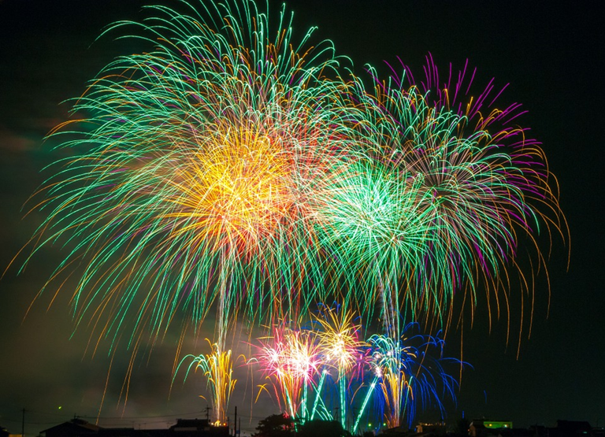
Signs of a chemical reaction
What are the signs of a chemical reaction?
Colour change
Gas produced (bubbles form)
Temperature change
Smell produced
Solid formed

Slide 3
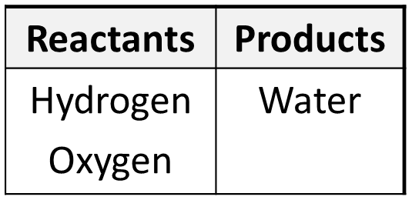
Reactants and Products
In a chemical reaction we start with one set of chemicals called the reactants.
A reaction happens and we end up with another set, called the products.
Example: when hydrogen and oxygen are reacted together they form water

Slide 4
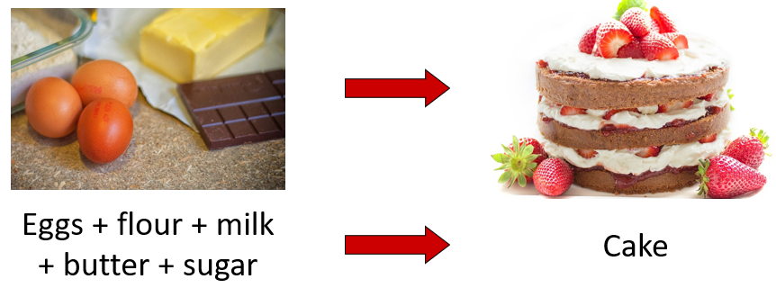
Word Equations
To show what is happening during a chemical reaction we can write a word equation
Reactants go on the left side, products on the right.

Slide 5
Word Equations
To show what is happening during a chemical reaction we can write a word equation
Reactants go on the left side of the equation
Products go on the right side of the equation

Slide 6
Word Equations
We use an arrow not an equals sign (=).
The arrow means “reacts to form”

Slide 7
Word Equations
In word equations we don’t use an equals sign (=).
We use an arrow that means:
“reacts to form”

Slide 8
Reactants and Products practice
When magnesium reacts with hydrochloric acid, magnesium chloride and hydrogen gas will be produced as per the word equation below.
magnesium + hydrochloric acid → magnesium chloride + hydrogen gas
a. What are the reactants?
magnesium and hydrochloric acid
b. What are the products?
magnesium chloride and hydrogen gas

Slide 9
Reactants and Products
In a car, when the engine is started enough energy is produced to combine nitrogen from the air with oxygen to form nitrogen dioxide.
a. What are the reactants?
nitrogen and oxygen
b. What the products?
nitrogen dioxide
c. What is the word equation?
nitrogen + oxygen → nitrogen dioxide

Slide 10
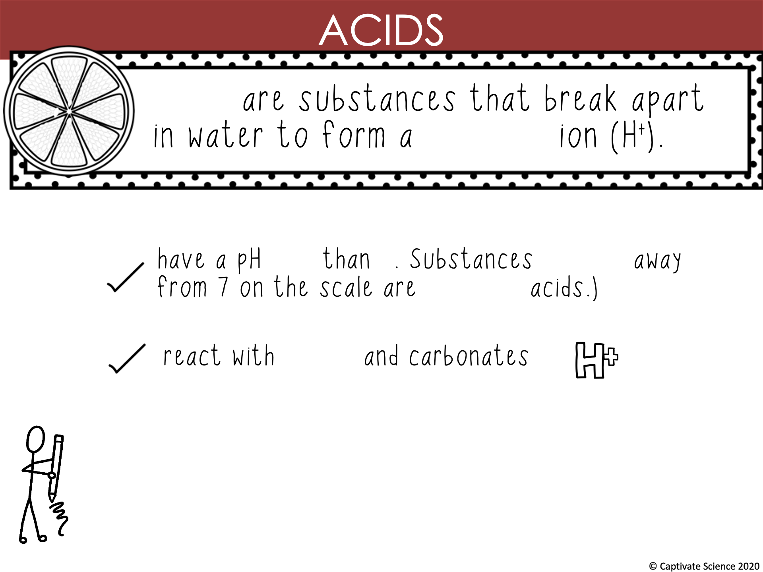
Acids
hydrogen
less 7 further
stronger
metal

Slide 11
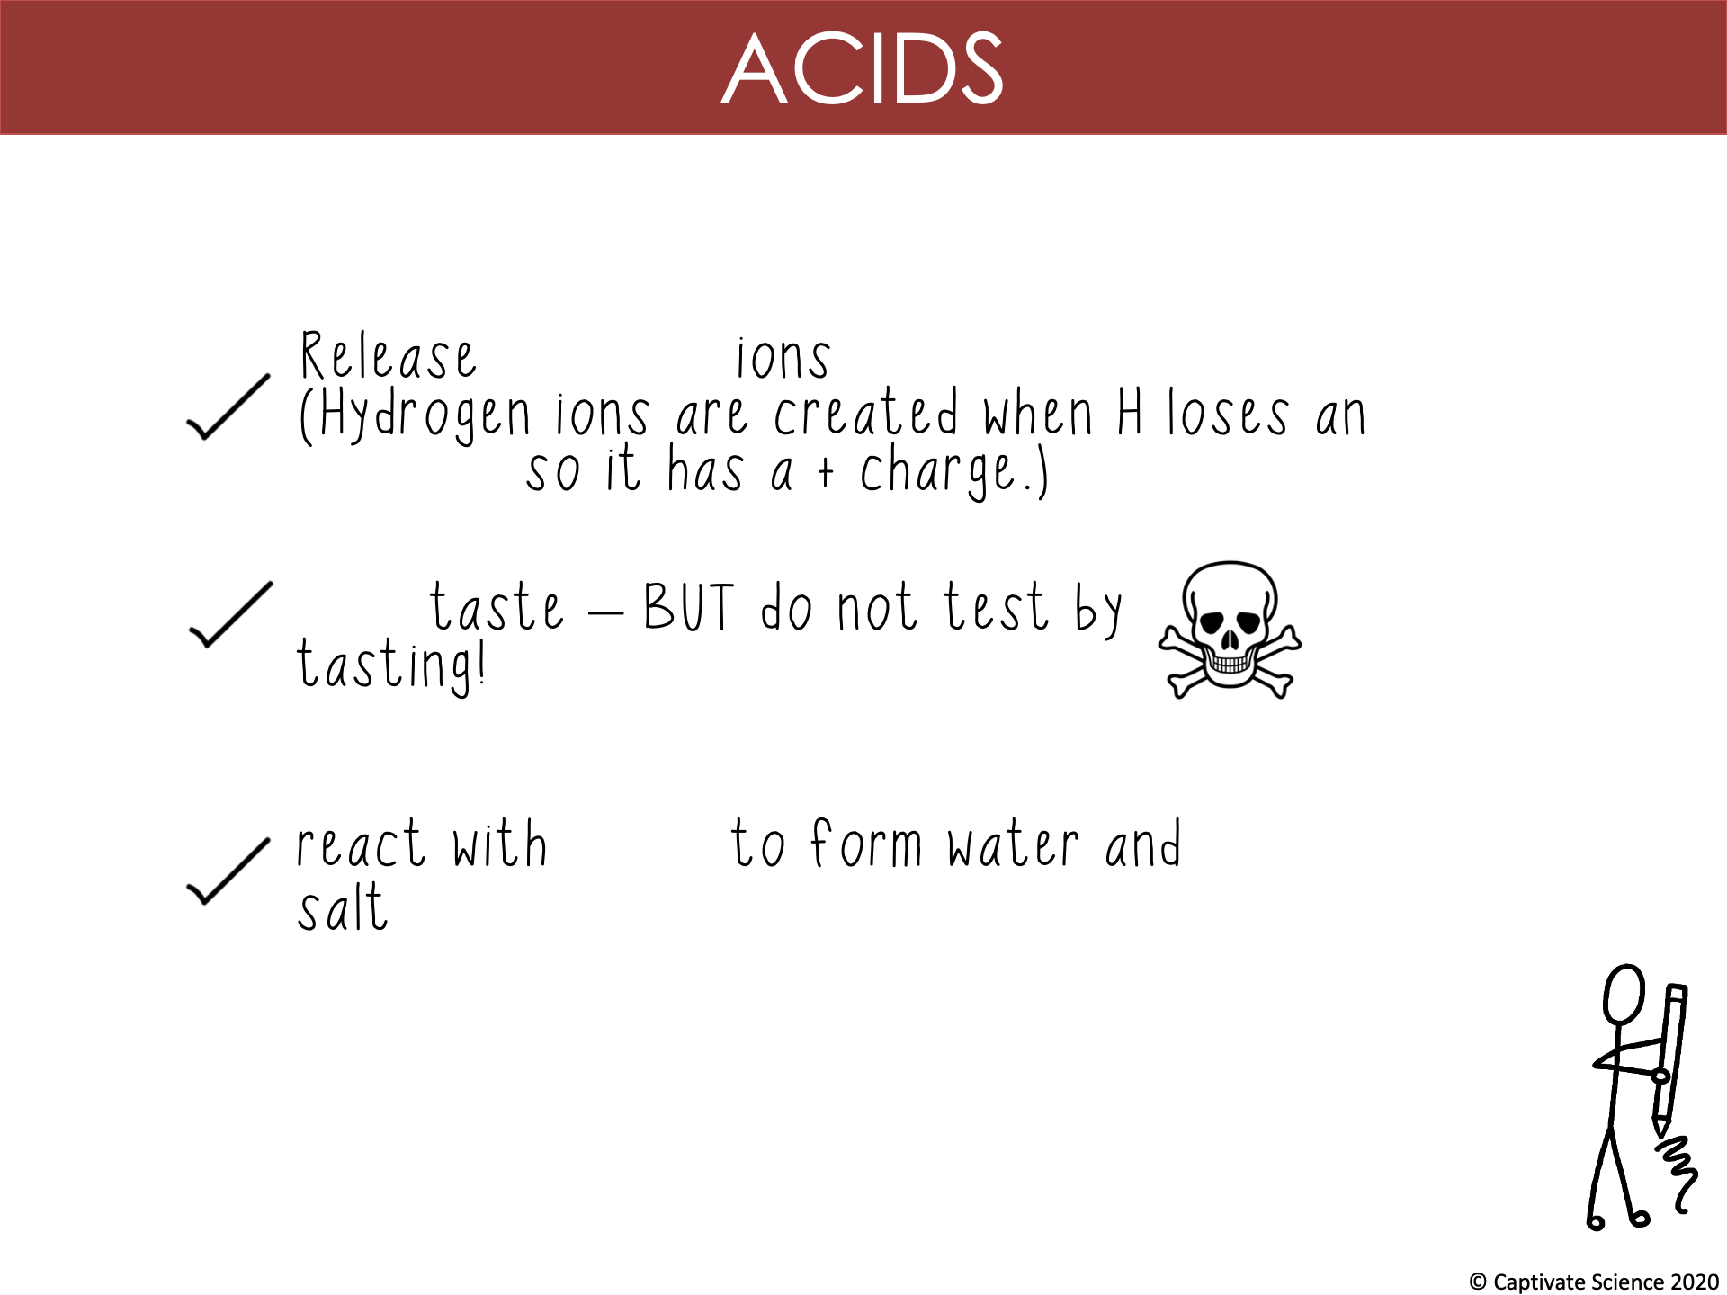
hydrogen
electron
sour
bases

Slide 12
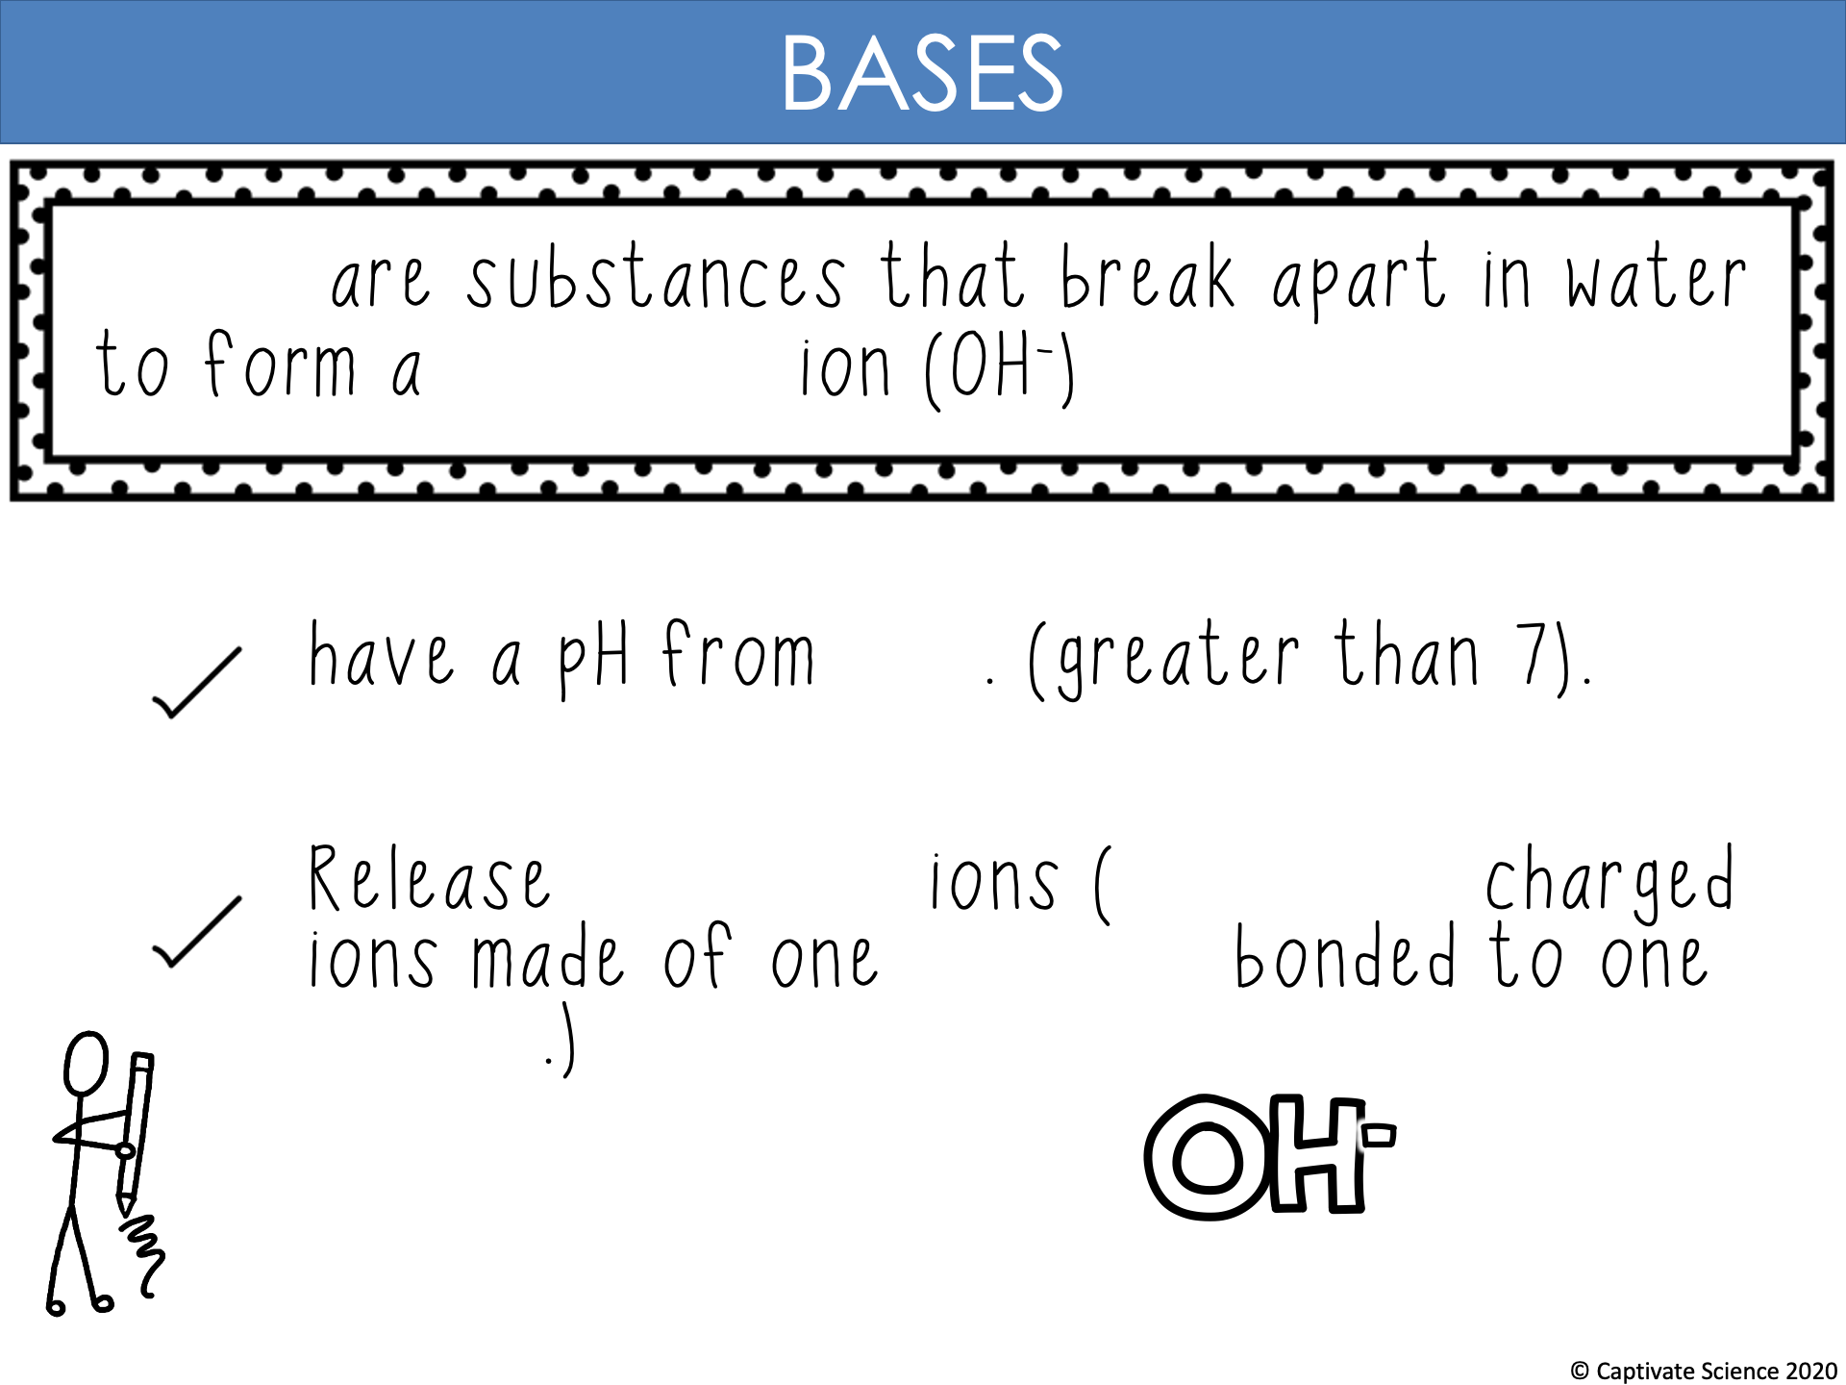
Bases
hydroxide
8-14
hydroxide
negatively
hydrogen
oxygen

Slide 13
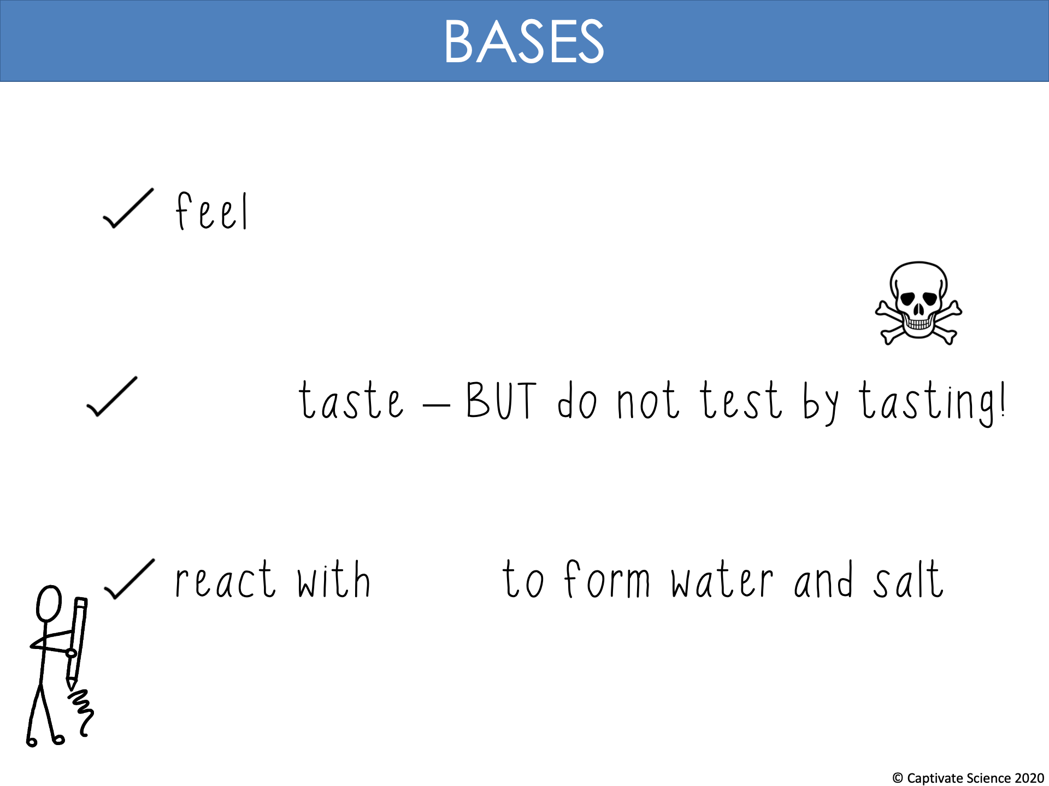
slippery
bitter
acids

Slide 14
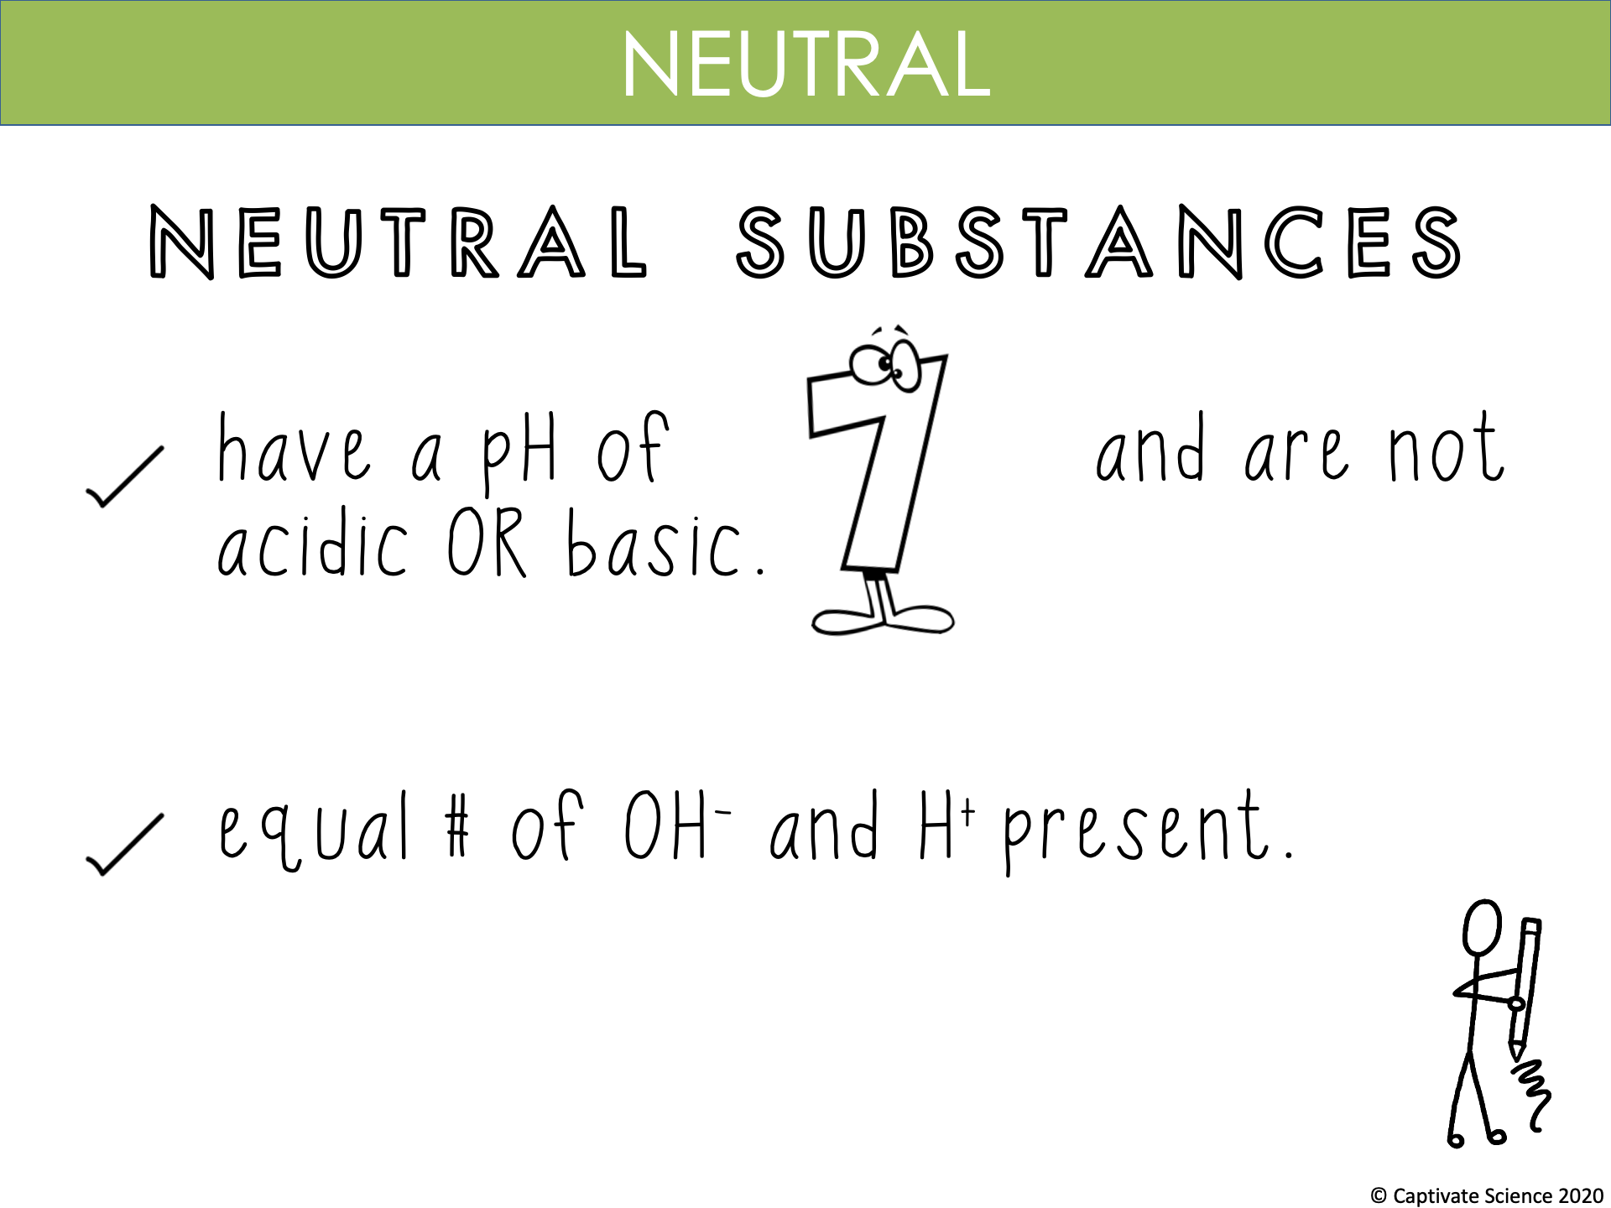

Slide 15
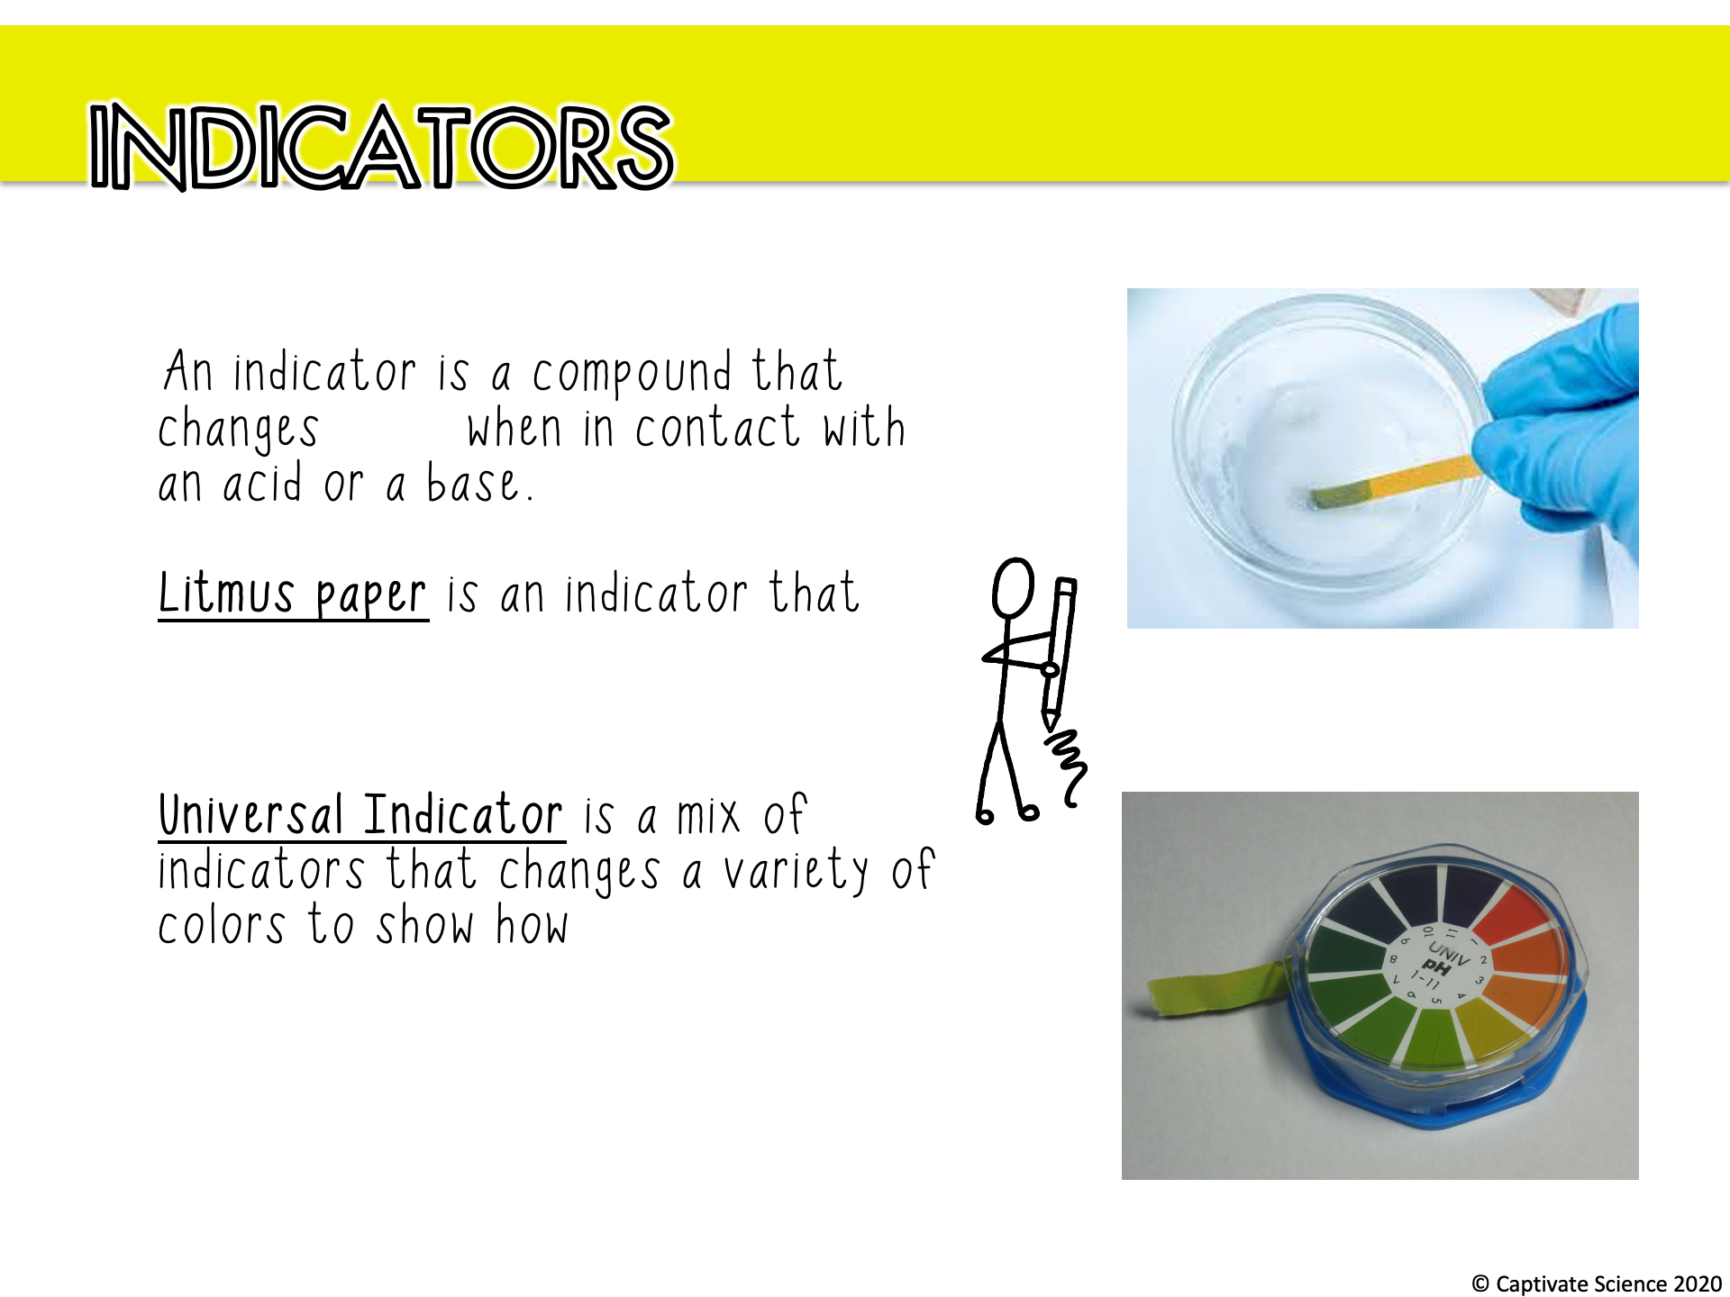
colour
turns RED in an acid and
BLUE in a base.
strong or weak an acid or base is.

Slide 16
We are revising chemical reactions, acids and bases
TRACK WITH ME
READ WITH ME
Students will be able to:
Identify reactants and products in chemical reactions
Write word equations to represent chemical reactions
Describe the general properties of acids and bases
Use the pH scale to make conclusions about a liquid’s acidity or alkalinity

